Slide 1

Real Estate
By
Alondra Aleman
Blessing Nwogu
Stephanie Garcia
Notes:
Introduce team

Slide 2

Introduction
Project Overview
Data Exploration
Questions
Conclusion
Notes:
Throughout our presentation we will begin by introducing the organization, realtor.com, and explain the overview of our project.
We will be discussing the methods used to explore the data and how they led to answering the questions we proposed.
Concluding our presentation, our team will state key highlights regarding our findings.

Slide 3
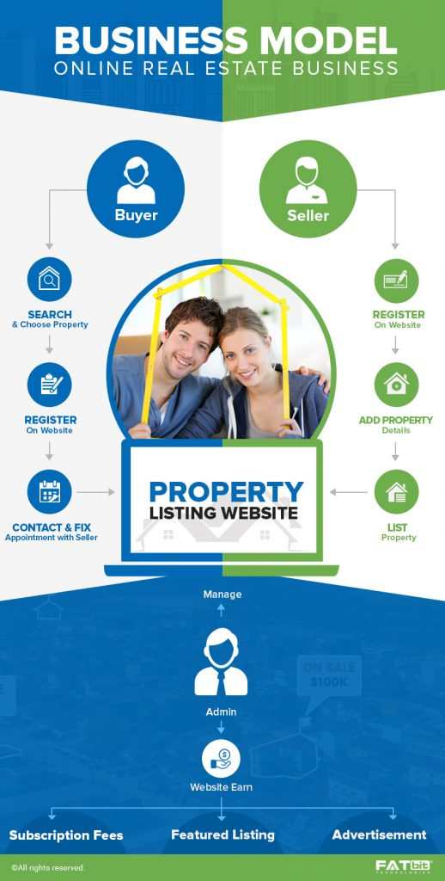
Introduction
Public real estate listing website
Launched in 1996 in Santa Clara, CA
Business model:
Connecting property buyers with sellers
Notes:
Realtor.com is a public real estate listing website that was launched in 1996 and is based in Santa Clara, California.
Realtor.com claims to be the largest real estate listing website in the United States and is valued at over $2.5 billion, according to Morgan Stanley.
The website is known for its award-winning advertising campaigns that have been recognized by Adweek and Webby Awards.
The business model for Realtor.com, a real estate listing website, is centered around connecting property buyers with sellers.
Realtor.com’s business model focuses on selling advertising to agents and brokers which in turn makes it easier for buyers and sellers to rent or buy properties.
The basic functions of a real estate listing website include renting, selling, and buying properties.

Slide 4
The Data
Residential properties in the United States
It was gotten from Realtor.com
It has over 77000 records and 28 variables. We used 10 variables
Year, Month, State, Prices, Hotness Score, Hotness Rank, Demand Score, Supply Score, Median days on the market, Listing’s Number of Days
The dataset was broken down by states and we focused on California
Notes:
Our project will be utilizing data from residential properties in the United States.
Realtor.com is the main source for the data presented in our dashboard.
The data itself is compiled of 77000 records and 28 variables.
For the purpose of our project, we focused on 10 variables.
As the dataset was organized by states, our team decided to focus on California.
It is common knowledge that California is one of the most expensive states to purchase a home and our team believed it would be interesting to see if the data reflected this.
Hotness Score: This this score is generated by looking at are by where homes sell fastest and have lots of potential buyers checking out each listing.
Hotness ranking is based on market demand, as measured by unique viewers per property on Realtor.com, and 2) the pace of the market as measured by the number of days a listing remains active on Realtor.com.

Slide 5

Project Overview
Objective:
Gain insights into the Real-Estate Industry in California using data from Realtor.com
Questions:
How do the listing prices on Realtor.com range in California?
What are the top 10 most and least expensive counties to purchase real-estate in California?
How does real-estate prices affect the days on the market?
How does real-estate prices affect the Hotness Score in different counties?

Slide 6
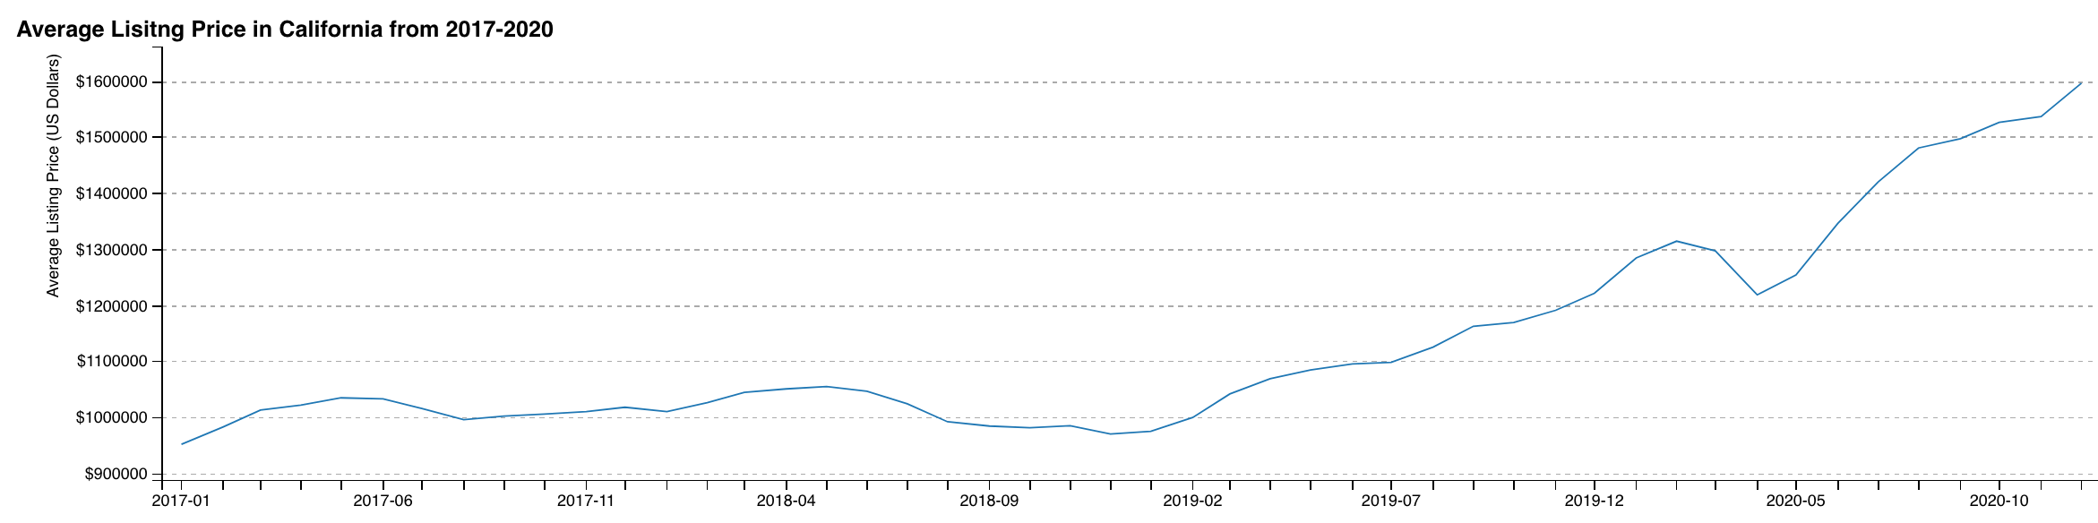
Data Exploration Listing Prices in California
Average Listing Prices on Realtor.com have been increasing since 2019
Average Listing Prices remained steady in 2017-2019

Slide 7

Q1: Do listing prices differ in California counties?
California consists of 58 Counties
Real-Estate Prices in California vary based on the county
Listing prices are different in California Counties based on location

Slide 8
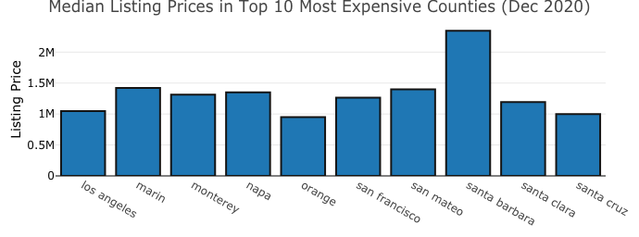
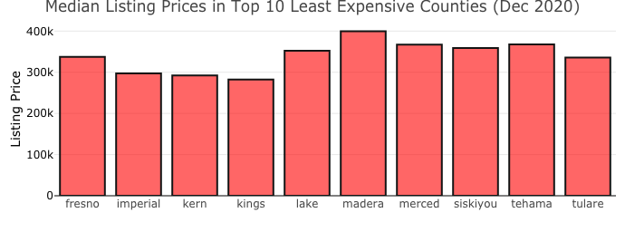
Q2: 10 Most and Least Expensive California Counties
These graphs are from a monthly snapshot of December 2020
The 10 most expensive counties are all priced in the millions
The 10 least expensive counties are priced below $400,000

Slide 9
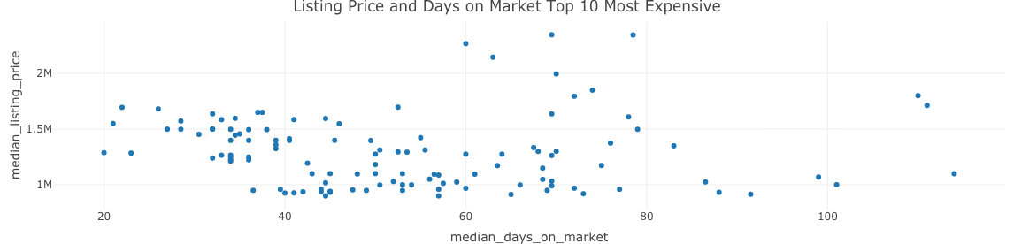
Q3: Do Listing prices affect days on Market?
This scatter chart plots median listing prices with median days on the market in the top 10 most expensive counties
Based on the scatter chart the days on the market are low when prices are lower

Slide 10
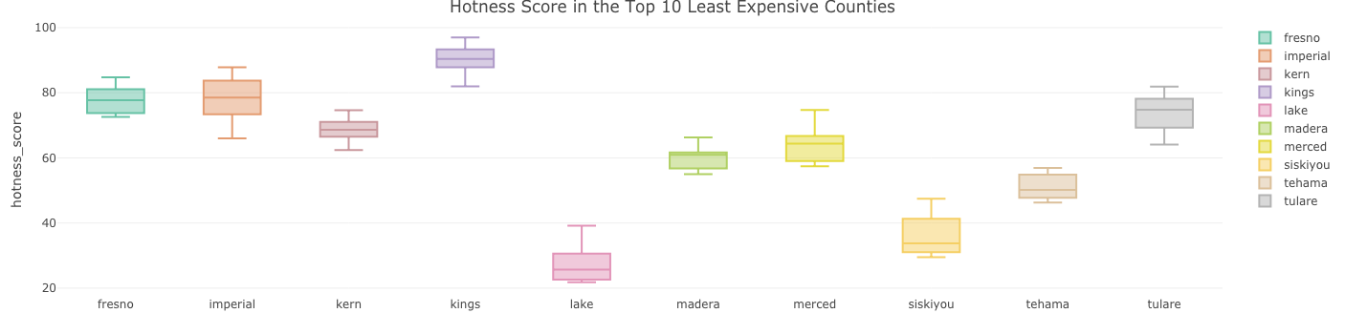
Q4: How does the hotness score differ In California counties?
Hotness Score: is an equally-weighted composite metric of a geography’s supply score and demand score
Below is a box plot illustrating the distribution of Hotness Score in the 10 least expensive counties

Slide 11

Conclusion
Gained insights into the components that make up the Real-Estate Industry
Focused on assessing the listing prices on Realtor.com
Analyzed the variables that can effect the price of real-estate
Determined where the highest and lowest prices are geographically in California
Learned that there are several variables that can effect the price of real-estate in California

Slide 12
References
Data Set 1 www.realtor.com/research/data/
Data Set 2 https://fred.stlouisfed.org/tags/series?t=market%20hotness%3Brealtor.com%3Busa&ob=pv&od=desc
How realtor works business & revenue model
https://futureworktechnologies.com/how-realtor-works-business-revenue-model

